Slide 1
CCBB internship summary
Miko lIU
MARCH 15TH, 2018
Notes:
summary of my internship and projects

Slide 2
Looking back…
Started end of June 2017: an incoming junior
A little overwhelmed
The Cloud, AWS, jobs on instances, source code, etc.
July 2017: On track!
Cirrus-NGS Pipeline: microRNA-seq, RNA-seq
Using Python, shell scripts, unit testing, Jupyter notebook, clusters...
Jan 2018: New project on pathway analysis with GSEA
Computational Biology! FUN!

Slide 3
Cirrus-NGS
Three main features:
Cloud-optimized next generation sequencing primary analysis pipelines for whole genome and exome variant calling, RNA-seq, miRNA-seq, ChIP-seq, DNA-seq.
User-friendly: the user does not need any bioinformatics software locally or advanced programming knowledge
Jupyter notebook: easy to run, easy to visualize the results

Slide 4
Simplified overview
Jupyter
notebook
Input design file
(local)
ec2-instance
S3 address
(remote storage)
Notes:
retrieve output from s3,
visualize the alignment results from Jupyter

Slide 5
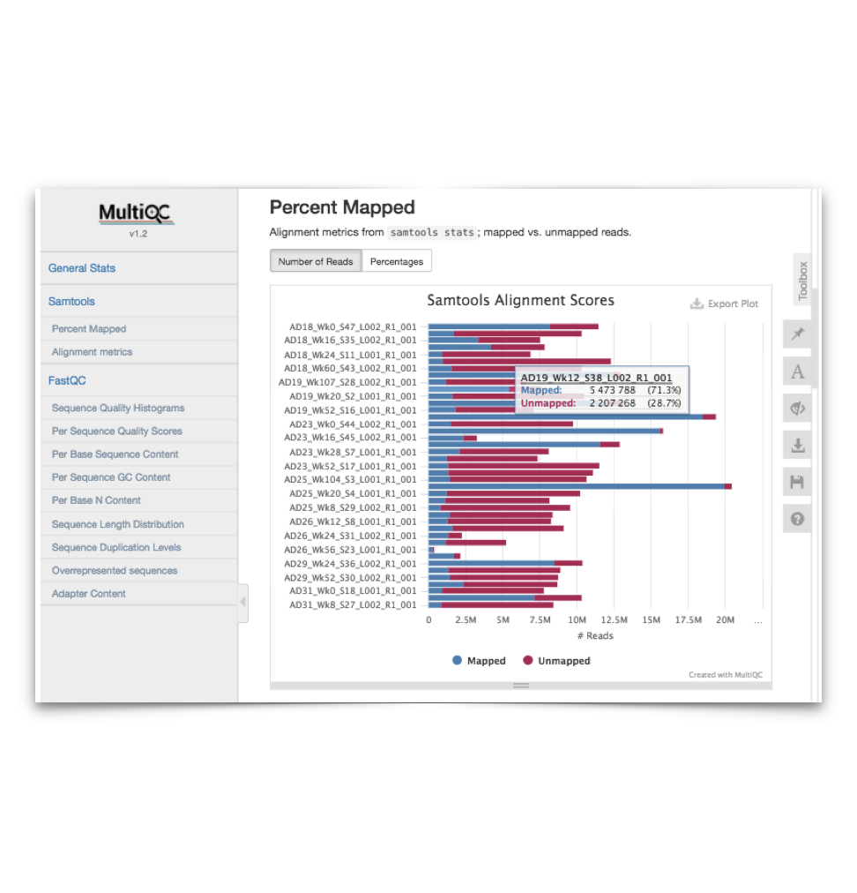
Alignment – quick look
Notes:
a section at the end of Jupyter
If a problem, go back to s3 and get the output files

Slide 6
My second project
Focus:
Interpret the results of gene expression profiles
Notes:
explode of data,
extract info from the data

Slide 7
Pathway analysis with GSEA: Gene Set Enrichment Analysis
What is it?
A method, whether a set of biologically relevant genes (e.g. a pathway) correlates with a phenotype.
Why is it important?
Unveil the relationship between genes in pathways and genes differentially expressed in a disease
Can determine if pathways are upregulated or downregulated
Part of network analysis workflow
How does it work?
Implemented in Jupyter with GSEApy
Notes:
GSEA is a method to identify the changes within a group of genes that could contribute to a disease.
Goal of GSEA: determine whether members of a gene set S tend to occur toward the top (or bottom) of the list L, in which case the gene set is correlated with the phenotypic class distinction.

Slide 8
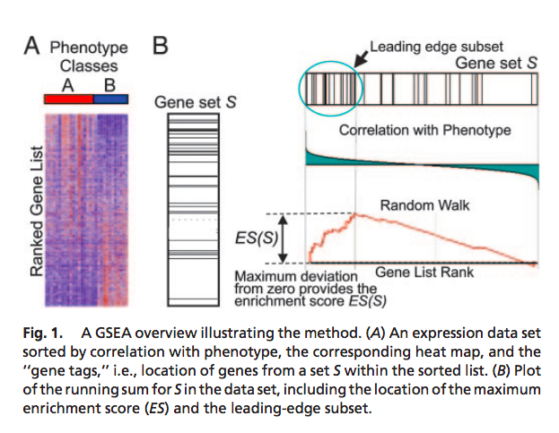
Some background
L: a ranked list of genes, by differential expression between the classes
S: our gene set (a pathway)
Bottom line:
If a gene set S (a pathway) falls at either the top (over-expressed) or bottom (under-expressed) of L, it is thought to be related to the phenotype.
Notes:
L: those showing the largest difference, most differentially expressed

Slide 9
Method of GSEA
--Gene Set Enrichment Analysis
1. Calculate enrichment score (ES):
ES: the degree of the gene set being over-represented at extremes of L
2. Estimate statistical significance (False discovery rate):
If FDR < 0.3, this gene set is significant in the enrichment
(How to Determine the significant pathway)
3. Adjust for multiple hypothesis testing:
Calculate normalized enrichment score (NES), etc.
Notes:
--Why do we find false discovery rate?
We may discover the genes are enriched by random chance, so this rate help us eliminate those findings that are untrustworthy and problematic.
--NES: ES/ mean(ESs against all permutations of dataset)
By normalizing the enrichment score, GSEA accounts for differences in gene set size and in correlations between gene sets and the expression dataset; therefore, the normalized enrichment scores (NES) can be used to compare analysis results across gene sets.

Slide 10
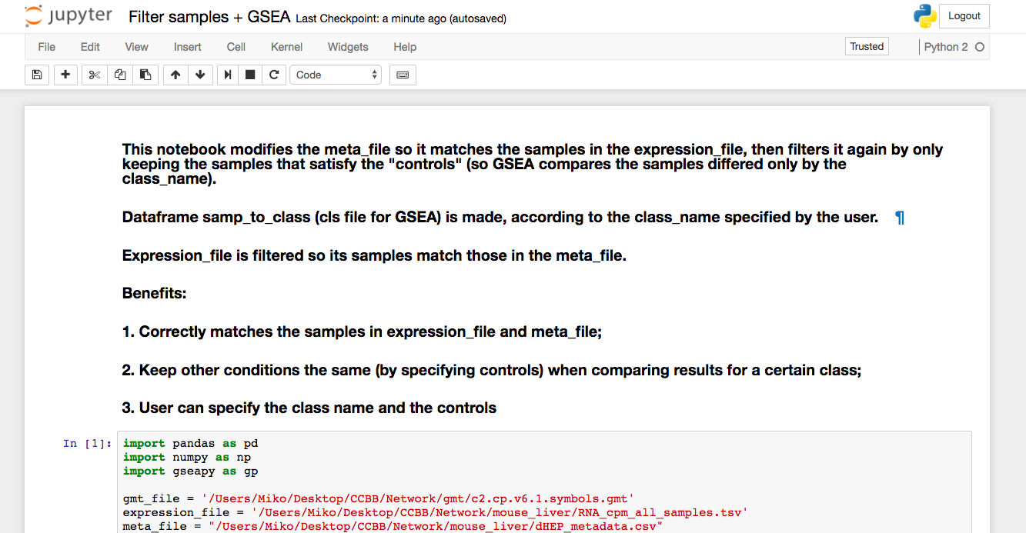

Slide 11
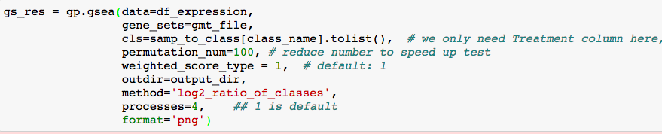
Call GSEA (after filtering)
mouse liver/liver tumor samples;
Controls in all other conditions

Slide 12
Genes: toward the bottom
Gene set may be correlated with tissue
Upregulated in liver tumor compared to liver normal
FDR < 0.3: significant pathway

Slide 13
Analysis of GSEA parameters
One observation: each run produces different results (significant pathways, p values, etc.)
This effect has to do with the permutation number: number of times to shuffle the genes in the gene set
Motivation:
find out a permutation number that gives us reliable results (consistent throughout runs), and runs in a reasonable amount of time.
Notes:
why shuffle:
--get a correct result, and reduce the probability of random chance discoveries
--TRADEOFF

Slide 14
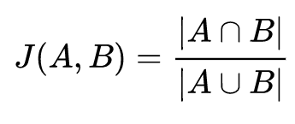
Measure of “reliability” - repeatability
Jaccard Index (Intersection over Union):
measures similarity between finite sample sets
Defined as:
Repeatability = intersection of the significant pathways of the samples/union of the significant pathways of the samples
Approach:
Step 1: Calculate repeatability for each permutation number
Step 2: Plot a graph showing the relationship between repeatability and permutation number

Slide 15
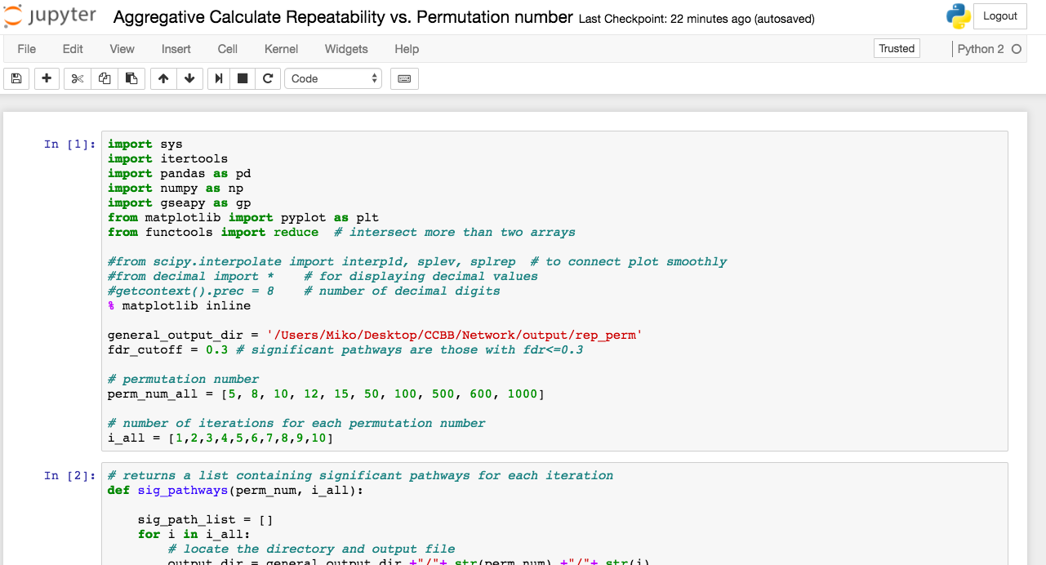
Notes:
For each perm, run 10 times

Slide 16
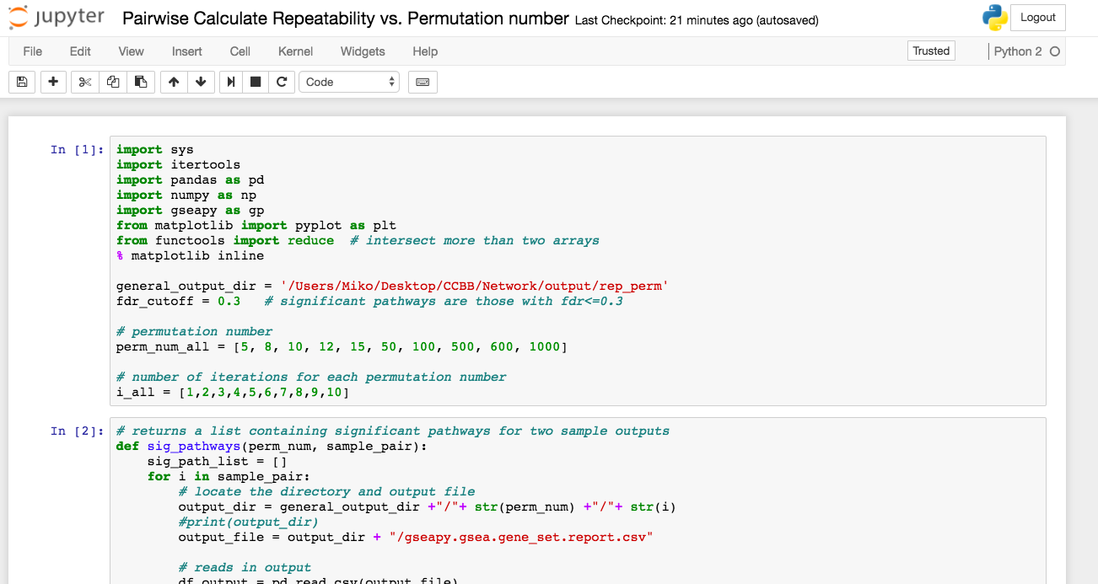
Notes:
pairwise calculation:
--take 2 out of the 10 iterations, for each permutation
--average Jaccard index
-better measurement

Slide 17
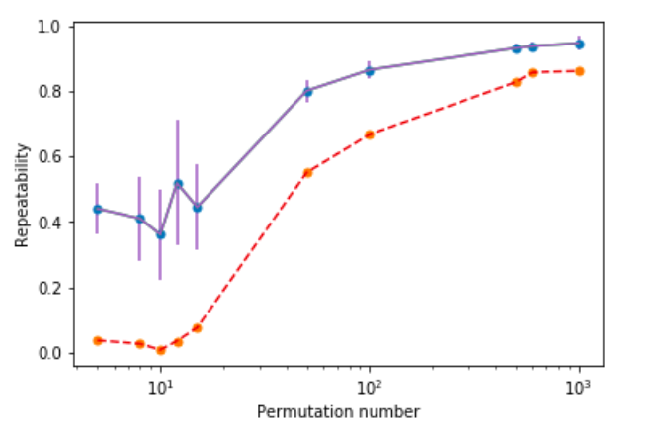
Findings
Permutation number=
[5, 8, 10, 12, 15, 50, 100, 500, 600, 1000]
600 is probably good enough
Note:
-the drop of repeatability near 10
-pairwise has higher repeatabilities
Purple = pairwise
Red = all 10 iterations
Notes:
Final plot I got

Slide 18
End note
Interaction with members at CCBB
Learn to appreciate what CCBB does for the community
Serve the biology research community; collaborate with Cancer center, etc.
Learn a lot from the experience: bioinfo, career, communication
Special thanks to my mentors (alphabetical order):
Amanda, Brin, Guorong, Katie
Notes:
Enjoy my interaction, career/academics
Last but not least:
SPECIAL THANKS

